Slide 1
Explicit Interaction Model towards Text Classification
Cunxiao Du, Zhaozheng Chen, Fuli Feng,
Lei Zhu, Tian Gan, Liqiang NiePiotr
(AAAI ‘19)
Kang Cho
chokang92 @ korea.ac.kr
Data Intelligence Lab, Korea University
2019.10.02

Slide 2
Problem Statement
How to reflect
fine-grained classification clues?

Slide 3
Motivation
Shoot the missile.

Slide 4
Motivation
Shoot the missile.
# military # sport
# game
# health

Slide 5
Motivation
Shoot the missile.
# military # sport
# game
# health

Slide 6
Motivation
Shoot the missile.
# military # sport
# game
# health
The word ‘missile’ strongly indicates the topic of military.

Slide 7
Motivation
Shoot the missile.
# military # sport
# game
# health
Fine-grained classification clue
- matching signals between words and classes

Slide 8
Motivation
Shoot the missile.
# military # sport
# game
# health
Fine-grained classification clue
- matching signals between words and classes
# military
shoot
the
missle
.

Slide 9
Motivation
Shoot the missile.
# military # sport
# game
# health
Fine-grained classification clue
- matching signals between words and classes
# military
shoot
the
missle
.

Slide 10
Motivation
Shoot the missile.
# military # sport
# game
# health
Fine-grained classification clue
- matching signals between words and classes
# military
shoot
the
missle
.

Slide 11
Motivation
Shoot the missile.
# military # sport
# game
# health
Fine-grained classification clue
- matching signals between words and classes
# military
shoot
the
missle
.

Slide 12
Motivation
Shoot the missile.
# military # sport
# game
# health
Fine-grained classification clue
- matching signals between words and classes
# military
shoot
the
missle
.

Slide 13
Motivation
Shoot the missile.
# military # sport
# game
# health
Fine-grained classification clue
- matching signals between words and classes
# military
shoot
the
missle
.
We classify classes with
more fine information.

Slide 14
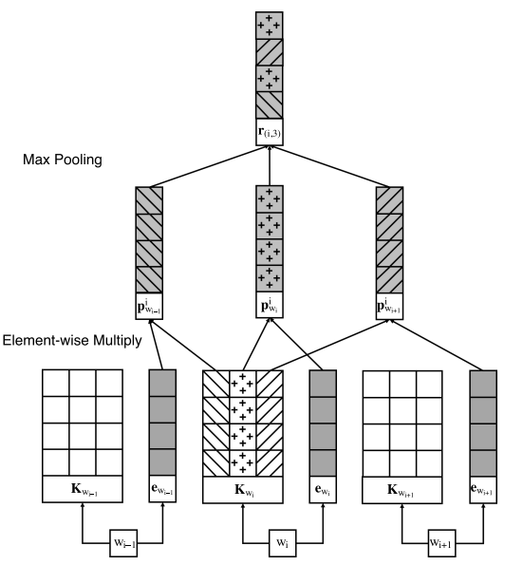
Previous Work
[Region Embedding]
Notes:
COMMUNICATION / COMMUNICATIVE

Slide 15
Previous Work
[Region Embedding]
The model utilizes task-specific distributed representation.
Notes:
COMMUNICATION / COMMUNICATIVE

Slide 16



Previous Work
[Region Embedding]
Text-level representation
SUM
〮 〮 〮
$$Word_{1}$$
$$Word_{2}$$
$$Word_{n}$$
The model utilizes task-specific distributed representation.
Notes:
COMMUNICATION / COMMUNICATIVE

Slide 17
Previous Work
[Region Embedding]
Text-level representation
SUM
〮 〮 〮
$$Word_{1}$$
$$Word_{2}$$
$$Word_{n}$$
This method Ignores the relationship between words and classes.
The model utilizes task-specific distributed representation.
Notes:
COMMUNICATION / COMMUNICATIVE

Slide 18
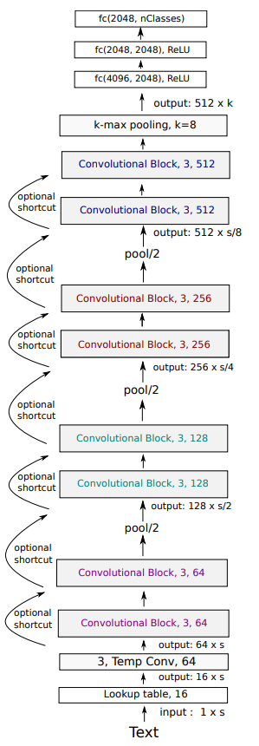
Previous Work
[VDCNN]
Notes:
COMMUNICATION / COMMUNICATIVE

Slide 19
Previous Work
[VDCNN]
Character-level representation
W h a t ㆍㆍㆍ n .
Notes:
COMMUNICATION / COMMUNICATIVE

Slide 20
Previous Work
[VDCNN]
Character-level representation
W h a t ㆍㆍㆍ n .
The characters are combined to form N-grams, words, and phrase which are helpful in classification.
Notes:
COMMUNICATION / COMMUNICATIVE

Slide 21
Previous Work
[VDCNN]
Character-level representation
W h a t ㆍㆍㆍ n .
The characters are combined to form N-grams, words, and phrase which are helpful in classification.
This char-based model should use a deep architecture to learn more combinations of characters.
Notes:
COMMUNICATION / COMMUNICATIVE

Slide 22
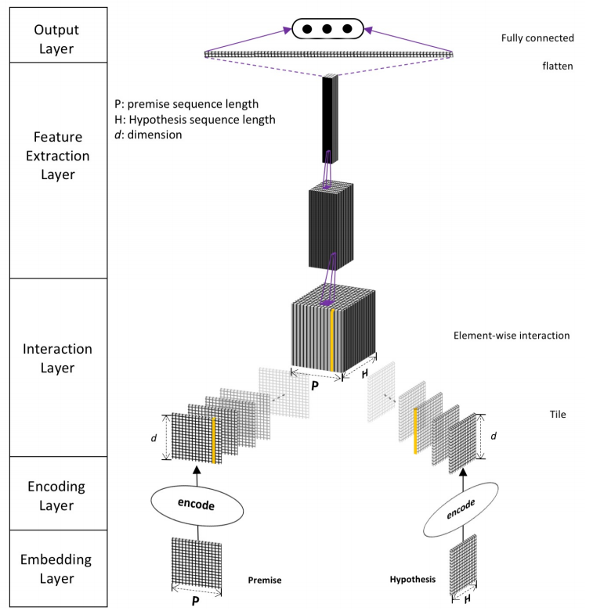
Previous Work
[Interactive Inference Network]
(NATURAL LANGUAGE INFERENCE OVER INTERACTION SPACE)
Notes:
COMMUNICATION / COMMUNICATIVE

Slide 23
Previous Work
[Interactive Inference Network]
(NATURAL LANGUAGE INFERENCE OVER INTERACTION SPACE)
The label
‘entailment’
He is so kind.
He is good man.
Notes:
COMMUNICATION / COMMUNICATIVE

Slide 24
Previous Work
[Interactive Inference Network]
(NATURAL LANGUAGE INFERENCE OVER INTERACTION SPACE)
The label
‘entailment’
He is so kind.
He is good man.
Notes:
COMMUNICATION / COMMUNICATIVE

Slide 25
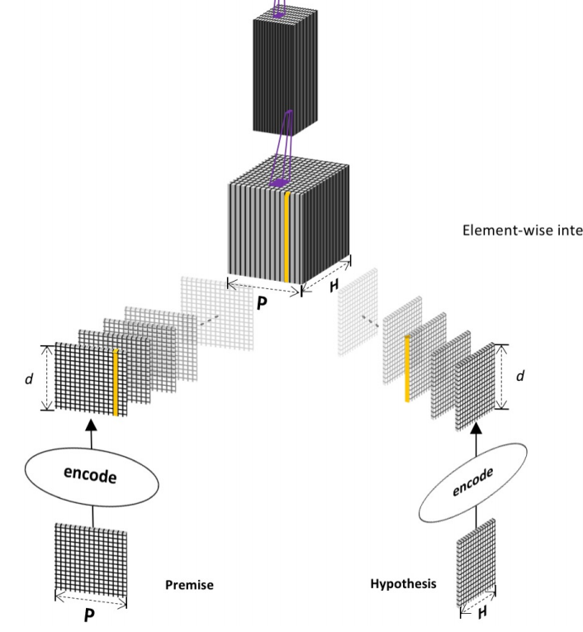
Previous Work
[Interactive Inference Network]
(NATURAL LANGUAGE INFERENCE OVER INTERACTION SPACE)
He 〮 〮 〮 kind .
He 〮 〮 〮 man .
Notes:
COMMUNICATION / COMMUNICATIVE

Slide 26
Previous Work
[Interactive Inference Network]
(NATURAL LANGUAGE INFERENCE OVER INTERACTION SPACE)
Outer Product
He 〮 〮 〮 kind .
He 〮 〮 〮 man .
Notes:
COMMUNICATION / COMMUNICATIVE

Slide 27
Previous Work
[Interactive Inference Network]
(NATURAL LANGUAGE INFERENCE OVER INTERACTION SPACE)
CNN
Outer Product
He 〮 〮 〮 kind .
He 〮 〮 〮 man .
Notes:
COMMUNICATION / COMMUNICATIVE

Slide 28
Previous Work
[Interactive Inference Network]
(NATURAL LANGUAGE INFERENCE OVER INTERACTION SPACE)
CNN
Outer Product
The computation cost is expensive.
He 〮 〮 〮 kind .
He 〮 〮 〮 man .
Notes:
COMMUNICATION / COMMUNICATIVE

Slide 29
Contribution
They prove the importance of reflecting the relationship between words and classes in text classification tasks.
They suggest a shallower model than a deep learning model based
on character-level.
The model is efficient using simple interaction mechanism to
incorporate word-level matching signals with classes.
Notes:
전체적인 문장 다듬을 것, 문법확인

Slide 30
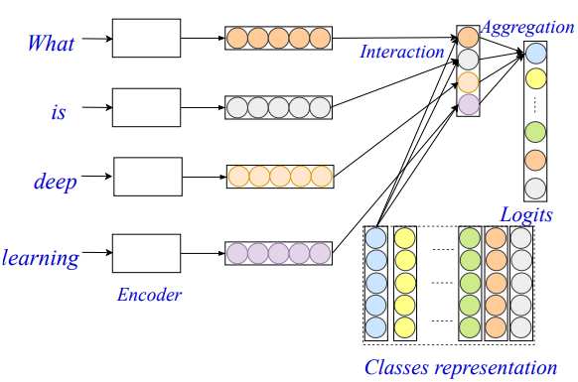
Model
[EXAM model]
Word-level Encoder
First component projects the input text
into a word-level representation.
Interaction Layer
Second component computes the interaction signals between the words and classes.
Aggregation Layer
Third component aggregate the interaction signals for each class and
make the final predictions.

Slide 31
Model
[EXAM model]
Word-level Encoder
First component projects the input text
into a word-level representation.
Interaction Layer
Second component computes the interaction signals between the words and classes.
Aggregation Layer
Third component aggregate the interaction signals for each class and
make the final predictions.

Slide 32
Model
[EXAM model]
Word-level Encoder
First component projects the input text
into a word-level representation.
Interaction Layer
Second component computes the interaction signals between the words and classes.
Aggregation Layer
Third component aggregate the interaction signals for each class and
make the final predictions.
Method 1) GRU
Method 2) Region Embedding

Slide 33
Model
[EXAM model]
Word-level Encoder
First component projects the input text
into a word-level representation.
Interaction Layer
Second component computes the interaction signals between the words and classes.
Aggregation Layer
Third component aggregate the interaction signals for each class and
make the final predictions.

Slide 34
Model
[EXAM model]
Dot product
Word-level Encoder
First component projects the input text
into a word-level representation.
Interaction Layer
Second component computes the interaction signals between the words and classes.
Aggregation Layer
Third component aggregate the interaction signals for each class and
make the final predictions.

Slide 35
Model
[EXAM model]
Word-level Encoder
First component projects the input text
into a word-level representation.
Interaction Layer
Second component computes the interaction signals between the words and classes.
Aggregation Layer
Third component aggregate the interaction signals for each class and
make the final predictions.

Slide 36
Model
[EXAM model]
FC
Word-level Encoder
First component projects the input text
into a word-level representation.
Interaction Layer
Second component computes the interaction signals between the words and classes.
Aggregation Layer
Third component aggregate the interaction signals for each class and
make the final predictions.

Slide 37
Model
[Word-level Encoder]
Method 1 - Gated Recurrent Units
Method 2 - Region Embedding

Slide 38
Model
[Word-level Encoder]
Method 1 - Gated Recurrent Units
Region Embedding
AND
Method 2 - Region Embedding
GRU
Word

Slide 39
Model
[Word-level Encoder]
Method 1 - Gated Recurrent Units
Region Embedding
AND
Method 2 - Region Embedding
GRU
Word

Slide 40
Model
[Word-level Encoder]
Method 1 - Gated Recurrent Units
Multi-Label task
GRU
Method 2 - Region Embedding
Word

Slide 41
Model
[Word-level Encoder]
Method 1 - Gated Recurrent Units
Multi-Label task
OR
GRU
Method 2 - Region Embedding
Word

Slide 42
Model
[Word-level Encoder]
Method 1 - Gated Recurrent Units
OR
Region Embedding
Method 2 - Region Embedding
Multi-Class task
Word

Slide 43
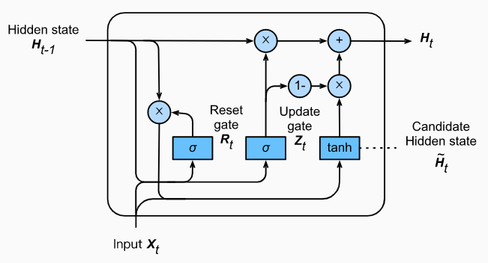
Model
[Word-level Encoder]
Gated Recurrent Units

Slide 44

Model
[Word-level Encoder]
Gated Recurrent Units
Reset Gate $R_{t} : σ(W_{xr}X_{t}+W_{hr}H_{t−1})$

Slide 45

Model
[Word-level Encoder]
Gated Recurrent Units
Reset Gate $R_{t} : σ(W_{xr}X_{t}+W_{hr}H_{t−1})$
$$\hat{H_{t}}=tanh⁡({W_{xh}X}_{t}+W_{hh}\left(R_{t}{ㆍH}_{t−1}\right))$$

Slide 46
Model
[Word-level Encoder]
Gated Recurrent Units
Reset Gate $R_{t} : σ(W_{xr}X_{t}+W_{hr}H_{t−1})$
$$\hat{H_{t}}=tanh⁡({W_{xh}X}_{t}+W_{hh}\left(R_{t}{ㆍH}_{t−1}\right))$$
The Gate controls the use
of previous information.

Slide 47

Model
[Word-level Encoder]
Gated Recurrent Units
Reset Gate $R_{t} : σ(W_{xr}X_{t}+W_{hr}H_{t−1})$
$$\hat{H_{t}}=tanh⁡({W_{xh}X}_{t}+W_{hh}\left(R_{t}{ㆍH}_{t−1}\right))$$
The Gate controls the use
of previous information.
Update Gate $Z_{t}: σ\left(X_{t}W_{xz}+H_{t−1}W_{hz}\right)$

Slide 48
Model
[Word-level Encoder]
Gated Recurrent Units
Reset Gate $R_{t} : σ(W_{xr}X_{t}+W_{hr}H_{t−1})$
$$\hat{H_{t}}=tanh⁡({W_{xh}X}_{t}+W_{hh}\left(R_{t}{ㆍH}_{t−1}\right))$$
The Gate controls the use
of previous information.
Update Gate $Z_{t}: σ\left(X_{t}W_{xz}+H_{t−1}W_{hz}\right)$
$$H_{t}=Z_{t}{ㆍH}_{t−1}+\left(1−Z_{t}\right)ㆍ \hat{H_{t}}$$

Slide 49
Model
[Word-level Encoder]
Gated Recurrent Units
Reset Gate $R_{t} : σ(W_{xr}X_{t}+W_{hr}H_{t−1})$
$$\hat{H_{t}}=tanh⁡({W_{xh}X}_{t}+W_{hh}\left(R_{t}{ㆍH}_{t−1}\right))$$
The Gate controls the use
of previous information.
Update Gate $Z_{t}: σ\left(X_{t}W_{xz}+H_{t−1}W_{hz}\right)$
$$H_{t}=Z_{t}{ㆍH}_{t−1}+\left(1−Z_{t}\right)ㆍ \hat{H_{t}}$$
The Gate determines the weight
ratio of previous information.

Slide 50
Model
[Word-level Encoder]
Gated Recurrent Units
Reset Gate $R_{t} : σ(W_{xr}X_{t}+W_{hr}H_{t−1})$
$$\hat{H_{t}}=tanh⁡({W_{xh}X}_{t}+W_{hh}\left(R_{t}{ㆍH}_{t−1}\right))$$
The Gate controls the use
of previous information.
Update Gate $Z_{t}: σ\left(X_{t}W_{xz}+H_{t−1}W_{hz}\right)$
$$H_{t}=Z_{t}{ㆍH}_{t−1}+\left(1−Z_{t}\right)ㆍ \hat{H_{t}}$$
The Gate determines the weight
ratio of previous information.
GRU has the ability of capturing sequential dependency.

Slide 51
Model
[Word-level Encoder]
2. Region Embedding
The food is not very good in this hotel.

Slide 52
Model
[Word-level Encoder]
2. Region Embedding
The food is not very good in this hotel.
$Position_{i−2}$ $Position_{i−1}$ $Position_{i}$ $Position_{i+1}$ $Position_{i+2}$

Slide 53
Model
[Word-level Encoder]
2. Region Embedding
The food is not very good in this hotel.
Region size : window size ⅹ 2 + 1
$Position_{i−2}$ $Position_{i−1}$ $Position_{i}$ $Position_{i+1}$ $Position_{i+2}$

Slide 54
Model
[Word-level Encoder]
2. Region Embedding
The food is not very good in this hotel.
Region size : window size ⅹ 2 + 1
$Position_{i−2}$ $Position_{i−1}$ $Position_{i}$ $Position_{i+1}$ $Position_{i+2}$
Embedding about meaning

Slide 55
Model
[Word-level Encoder]
2. Region Embedding
The food is not very good in this hotel.
Region size : window size ⅹ 2 + 1
$Position_{i−2}$ $Position_{i−1}$ $Position_{i}$ $Position_{i+1}$ $Position_{i+2}$
Embedding about meaning
Embedding about position

Slide 56
Model
[Word-level Encoder]
2. Region Embedding
The food is not very good in this hotel.
Region size : window size ⅹ 2 + 1
$Position_{i−2}$ $Position_{i−1}$ $Position_{i}$ $Position_{i+1}$ $Position_{i+2}$
Meaning
Embedding about meaning
$Position_{i−2}$ $Position_{i−1}$ $Position_{i}$ $Position_{i+1}$ $Position_{i+2}$
Embedding about position

Slide 57





Model
[Word-level Encoder]
2. Region Embedding
The food is not very good in this hotel.
$Position_{i−2}$ $Position_{i−1}$ $Position_{i}$ $Position_{i+1}$ $Position_{i+2}$
Embedding weight about meaning
Lookup
food
$${e_{not}}_{i−2}$$
is
${e_{not}}_{i−1}$
not
$${e_{not}}_{i}$$
very
$${e_{not}}_{i+1}$$
good
$${e_{not}}_{i+2}$$

Slide 58
Model
[Word-level Encoder]
2. Region Embedding
The food is not very good in this hotel.
$Position_{i−2}$ $Position_{i−1}$ $Position_{i}$ $Position_{i+1}$ $Position_{i+2}$
Embedding weight about meaning
Lookup
food
$${e_{not}}_{i−2}$$
Concate
is
${e_{not}}_{i−1}$
not
$${e_{not}}_{i}$$
very
$${e_{not}}_{i+1}$$
good
$${e_{not}}_{i+2}$$

Slide 59
Model
[Word-level Encoder]
2. Region Embedding
The food is not very good in this hotel.
$Position_{i−2}$ $Position_{i−1}$ $Position_{i}$ $Position_{i+1}$ $Position_{i+2}$
Embedding weight about position
$Position_{i−2}$ $Position_{i−1}$ $Position_{i}$ $Position_{i+1}$ $Position_{i+2}$
not

Slide 60
Model
[Word-level Encoder]
2. Region Embedding
The food is not very good in this hotel.
$Position_{i−2}$ $Position_{i−1}$ $Position_{i}$ $Position_{i+1}$ $Position_{i+2}$
Embedding weight about position
$Position_{i−2}$ $Position_{i−1}$ $Position_{i}$ $Position_{i+1}$ $Position_{i+2}$
not
Concate

Slide 61





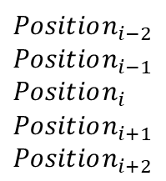
Model
[Word-level Encoder]
2. Region Embedding
The food is not very good in this hotel.
$Position_{i−2}$ $Position_{i−1}$ $Position_{i}$ $Position_{i+1}$ $Position_{i+2}$
$Position_{i−2}$
$Position_{i−1}$
$Position_{i}$
$Position_{i+1}$
$Position_{i+2}$
$${e_{not}}_{i−2}$$
$${e_{not}}_{i−1}$$
$${e_{not}}_{i}$$
$${e_{not}}_{i+1}$$
$${e_{not}}_{i+2}$$

Slide 62
Model
[Word-level Encoder]
2. Region Embedding
The food is not very good in this hotel.
$Position_{i−2}$ $Position_{i−1}$ $Position_{i}$ $Position_{i+1}$ $Position_{i+2}$
Element-wise
multiplication
$Position_{i−2}$
$Position_{i−1}$
$Position_{i}$
$Position_{i+1}$
$Position_{i+2}$
$${e_{not}}_{i−2}$$
$${e_{not}}_{i−1}$$
$${e_{not}}_{i}$$
$${e_{not}}_{i+1}$$
$${e_{not}}_{i+2}$$

Slide 63
Model
[Word-level Encoder]
2. Region Embedding
The food is not very good in this hotel.
$Position_{i−2}$ $Position_{i−1}$ $Position_{i}$ $Position_{i+1}$ $Position_{i+2}$
Element-wise
multiplication
$Position_{i−2}$
$Position_{i−1}$
$Position_{i}$
$Position_{i+1}$
$Position_{i+2}$
$${e_{not}}_{i−2}$$
$${e_{not}}_{i−1}$$
$${e_{not}}_{i}$$
$${e_{not}}_{i+1}$$
$${e_{not}}_{i+2}$$

Slide 64
Model
[Word-level Encoder]
2. Region Embedding
The food is not very good in this hotel.
$Position_{i−2}$ $Position_{i−1}$ $Position_{i}$ $Position_{i+1}$ $Position_{i+2}$
Element-wise
multiplication
$Position_{i−2}$
$Position_{i−1}$
$Position_{i}$
$Position_{i+1}$
$Position_{i+2}$
$${e_{not}}_{i−2}$$
$${e_{not}}_{i−1}$$
$${e_{not}}_{i}$$
$${e_{not}}_{i+1}$$
$${e_{not}}_{i+2}$$

Slide 65
Model
[Word-level Encoder]
2. Region Embedding
The food is not very good in this hotel.
$Position_{i−2}$ $Position_{i−1}$ $Position_{i}$ $Position_{i+1}$ $Position_{i+2}$
Element-wise
multiplication
$Position_{i−2}$
$Position_{i−1}$
$Position_{i}$
$Position_{i+1}$
$Position_{i+2}$
$${e_{not}}_{i−2}$$
$${e_{not}}_{i−1}$$
$${e_{not}}_{i}$$
$${e_{not}}_{i+1}$$
$${e_{not}}_{i+2}$$

Slide 66
Model
[Word-level Encoder]
2. Region Embedding
The food is not very good in this hotel.
$Position_{i−2}$ $Position_{i−1}$ $Position_{i}$ $Position_{i+1}$ $Position_{i+2}$
Element-wise
multiplication
$Position_{i−2}$
$Position_{i−1}$
$Position_{i}$
$Position_{i+1}$
$Position_{i+2}$
$${e_{not}}_{i−2}$$
$${e_{not}}_{i−1}$$
$${e_{not}}_{i}$$
$${e_{not}}_{i+1}$$
$${e_{not}}_{i+2}$$

Slide 67
Model
[Word-level Encoder]
2. Region Embedding
The food is not very good in this hotel.
$Position_{i−2}$ $Position_{i−1}$ $Position_{i}$ $Position_{i+1}$ $Position_{i+2}$
Element-wise
multiplication
$Position_{i−2}$
$Position_{i−1}$
$Position_{i}$
$Position_{i+1}$
$Position_{i+2}$
$${e_{not}}_{i−2}$$
$${e_{not}}_{i−1}$$
$${e_{not}}_{i}$$
$${e_{not}}_{i+1}$$
$${e_{not}}_{i+2}$$

Slide 68
Model
[Word-level Encoder]
2. Region Embedding
The food is not very good in this hotel.
$Position_{i−2}$ $Position_{i−1}$ $Position_{i}$ $Position_{i+1}$ $Position_{i+2}$
Element-wise
multiplication
$Position_{i−2}$
$Position_{i−1}$
$Position_{i}$
$Position_{i+1}$
$Position_{i+2}$
$${e_{not}}_{i−2}$$
$${e_{not}}_{i−1}$$
$${e_{not}}_{i}$$
$${e_{not}}_{i+1}$$
Max-pooling
$${e_{not}}_{i+2}$$

Slide 69
Model
[Word-level Encoder]
2. Region Embedding
The food is not very good in this hotel.
$Position_{i−2}$ $Position_{i−1}$ $Position_{i}$ $Position_{i+1}$ $Position_{i+2}$
Element-wise
multiplication
$Position_{i−2}$
$Position_{i−1}$
$Position_{i}$
$Position_{i+1}$
$Position_{i+2}$
$${e_{not}}_{i−2}$$
$${e_{not}}_{i−1}$$
$${e_{not}}_{i}$$
$${e_{not}}_{i+1}$$
Max-pooling
$${e_{not}}_{i+2}$$

Slide 70
Model
[Word-level Encoder]
2. Region Embedding
The food is not very good in this hotel.
$Position_{i−2}$ $Position_{i−1}$ $Position_{i}$ $Position_{i+1}$ $Position_{i+2}$
Element-wise
multiplication
$Position_{i−2}$
$Position_{i−1}$
$Position_{i}$
$Position_{i+1}$
$Position_{i+2}$
$${e_{not}}_{i−2}$$
$${e_{not}}_{i−1}$$
$${e_{not}}_{i}$$
$${e_{not}}_{i+1}$$
Max-pooling
$${e_{not}}_{i+2}$$

Slide 71
Model
[Word-level Encoder]
2. Region Embedding
The food is not very good in this hotel.
$Position_{i−2}$ $Position_{i−1}$ $Position_{i}$ $Position_{i+1}$ $Position_{i+2}$
Element-wise
multiplication
$Position_{i−2}$
$Position_{i−1}$
$Position_{i}$
$Position_{i+1}$
$Position_{i+2}$
$${e_{not}}_{i−2}$$
$${e_{not}}_{i−1}$$
$${e_{not}}_{i}$$
$${e_{not}}_{i+1}$$
Max-pooling
$${e_{not}}_{i+2}$$

Slide 72
Model
[Word-level Encoder]
2. Region Embedding
The food is not very good in this hotel.
$Position_{i−2}$ $Position_{i−1}$ $Position_{i}$ $Position_{i+1}$ $Position_{i+2}$
Element-wise
multiplication
$Position_{i−2}$
$Position_{i−1}$
$Position_{i}$
$Position_{i+1}$
$Position_{i+2}$
$${e_{not}}_{i−2}$$
$${e_{not}}_{i−1}$$
$${e_{not}}_{i}$$
$${e_{not}}_{i+1}$$
Max-pooling
$${e_{not}}_{i+2}$$
: Embedding on
the word ‘not’

Slide 73
Model
[Word-level Encoder]
To utilizing task-specific
distributed representation.
2. Region Embedding
The food is not very good in this hotel.
$Position_{i−2}$ $Position_{i−1}$ $Position_{i}$ $Position_{i+1}$ $Position_{i+2}$
Element-wise
multiplication
$Position_{i−2}$
$Position_{i−1}$
$Position_{i}$
$Position_{i+1}$
$Position_{i+2}$
$${e_{not}}_{i−2}$$
$${e_{not}}_{i−1}$$
$${e_{not}}_{i}$$
$${e_{not}}_{i+1}$$
Max-pooling
$${e_{not}}_{i+2}$$
: Embedding on
the word ‘not’

Slide 74
Model
[Word-level Encoder]
What is the difference between GRU and Region Embedding?
GRU
Region Embedding
- The ability of capturing sequential
dependency.
- The ability of getting embedding that
reflect context within sentences.
Features
- GRU does not solve gradient vanishing and
explosion problems when the length of
sentences is long.
- Gradient vanishing and explosion
problems do not occur.

Slide 75
Model
[Word-level Encoder]
What is the difference between GRU and Region Embedding?
GRU
Region Embedding
- The ability of capturing sequential
dependency.
- The ability of getting embedding that
reflect context within sentences.
Features
- GRU does not solve gradient vanishing and
explosion problems when the length of
sentences is long.
- Gradient vanishing and explosion
problems do not occur.
Use GRU in short sentences.

Slide 76
Model
[Word-level Encoder]
What is the difference between GRU and Region Embedding?
GRU
Region Embedding
- The ability of capturing sequential
dependency.
- The ability of getting embedding that
reflect context within sentences.
Features
- GRU does not solve gradient vanishing and
explosion problems when the length of
sentences is long.
- Gradient vanishing and explosion
problems do not occur.
Use GRU in short sentences.
Use Region Embedding in long sentences.

Slide 77
Model
[Interaction Layer]

Slide 78
Model
[Interaction Layer]
Dot product

Slide 79
Model
[Interaction Layer]
Word representation
Class representation
what
is :
deep
learning
: [ 1 1 1 1 1 ]
: [ 2 2 2 2 2 ]
: [ 3 3 3 3 3 ]
: [ 4 4 4 4 4 ]
: [ 5 5 5 5 5 ]
: [ 6 6 6 6 6 ]
: [ 7 7 7 7 7 ]
: [ 8 8 8 8 8 ]
#science
#sport :
#human
#health
Dot product

Slide 80
Model
[Interaction Layer]
Word representation
Class representation
what
is :
deep
learning
: [ 1 1 1 1 1 ]
: [ 2 2 2 2 2 ]
: [ 3 3 3 3 3 ]
: [ 4 4 4 4 4 ]
: [ 5 5 5 5 5 ]
: [ 6 6 6 6 6 ]
: [ 7 7 7 7 7 ]
: [ 8 8 8 8 8 ]
#science
#sport :
#human
#health
Dot product
Matching score
Between the words and classes

Slide 81
Model
[Interaction Layer]
Word representation
Class representation
what
is :
deep
learning
: [ 1 1 1 1 1 ]
: [ 2 2 2 2 2 ]
: [ 3 3 3 3 3 ]
: [ 4 4 4 4 4 ]
: [ 5 5 5 5 5 ]
: [ 6 6 6 6 6 ]
: [ 7 7 7 7 7 ]
: [ 8 8 8 8 8 ]
#science
#sport :
#human
#health
Dot product
Matching score
Between the words and classes
#science
: [ 25 50 75 100 ]
what

Slide 82
Model
[Interaction Layer]
Word representation
Class representation
what
is :
deep
learning
: [ 1 1 1 1 1 ]
: [ 2 2 2 2 2 ]
: [ 3 3 3 3 3 ]
: [ 4 4 4 4 4 ]
: [ 5 5 5 5 5 ]
: [ 6 6 6 6 6 ]
: [ 7 7 7 7 7 ]
: [ 8 8 8 8 8 ]
#science
#sport :
#human
#health
Dot product
Matching score
Between the words and classes
#science
: [ 25 50 75 100 ]
is

Slide 83
Model
[Interaction Layer]
Word representation
Class representation
what
is :
deep
learning
: [ 1 1 1 1 1 ]
: [ 2 2 2 2 2 ]
: [ 3 3 3 3 3 ]
: [ 4 4 4 4 4 ]
: [ 5 5 5 5 5 ]
: [ 6 6 6 6 6 ]
: [ 7 7 7 7 7 ]
: [ 8 8 8 8 8 ]
#science
#sport :
#human
#health
Dot product
Matching score
Between the words and classes
#science
: [ 25 50 75 100 ]
deep

Slide 84
Model
[Interaction Layer]
Word representation
Class representation
what
is :
deep
learning
: [ 1 1 1 1 1 ]
: [ 2 2 2 2 2 ]
: [ 3 3 3 3 3 ]
: [ 4 4 4 4 4 ]
: [ 5 5 5 5 5 ]
: [ 6 6 6 6 6 ]
: [ 7 7 7 7 7 ]
: [ 8 8 8 8 8 ]
#science
#sport :
#human
#health
Dot product
Matching score
Between the words and classes
#science
: [ 25 50 75 100 ]
learning

Slide 85
Model
[Interaction Layer]
Word representation
Class representation
what
is :
deep
learning
: [ 1 1 1 1 1 ]
: [ 2 2 2 2 2 ]
: [ 3 3 3 3 3 ]
: [ 4 4 4 4 4 ]
: [ 5 5 5 5 5 ]
: [ 6 6 6 6 6 ]
: [ 7 7 7 7 7 ]
: [ 8 8 8 8 8 ]
#science
#sport :
#human
#health
Dot product
Matching score
Between the words and classes
#science
: [ 25 50 75 100 ]

Slide 86
Model
[Interaction Layer]
Word representation
Class representation
what
is :
deep
learning
: [ 1 1 1 1 1 ]
: [ 2 2 2 2 2 ]
: [ 3 3 3 3 3 ]
: [ 4 4 4 4 4 ]
: [ 5 5 5 5 5 ]
: [ 6 6 6 6 6 ]
: [ 7 7 7 7 7 ]
: [ 8 8 8 8 8 ]
#science
#sport :
#human
#health
Dot product
Matching score
Between the words and classes
#science
#sport
#human
#health
: [ 25 50 75 100 ]
: [ 30 60 90 120 ]
: [ 35 70 105 140 ]
: [ 40 80 120 160 ]
what
is
deep
learning

Slide 87
Model
[Interaction Layer]
Word representation
Class representation
what
is :
deep
learning
: [ 1 1 1 1 1 ]
: [ 2 2 2 2 2 ]
: [ 3 3 3 3 3 ]
: [ 4 4 4 4 4 ]
: [ 5 5 5 5 5 ]
: [ 6 6 6 6 6 ]
: [ 7 7 7 7 7 ]
: [ 8 8 8 8 8 ]
#science
#sport :
#human
#health
Dot product
Matching score
Between the words and classes
#science
#sport
#human
#health
: [ 25 50 75 100 ]
: [ 30 60 90 120 ]
: [ 35 70 105 140 ]
: [ 40 80 120 160 ]
what
is
deep
learning

Slide 88
Model
[Interaction Layer]
Word representation
Class representation
what
is :
deep
learning
: [ 1 1 1 1 1 ]
: [ 2 2 2 2 2 ]
: [ 3 3 3 3 3 ]
: [ 4 4 4 4 4 ]
: [ 5 5 5 5 5 ]
: [ 6 6 6 6 6 ]
: [ 7 7 7 7 7 ]
: [ 8 8 8 8 8 ]
#science
#sport :
#human
#health
Dot product
Matching score
Between the words and classes
#science
#sport
#human
#health
: [ 25 50 75 100 ]
: [ 30 60 90 120 ]
: [ 35 70 105 140 ]
: [ 40 80 120 160 ]
what
is
deep
learning

Slide 89
Model
[Interaction Layer]
What effects can we get through interaction layer?
- If not?
The model can only learn the relationship
between a text-level representation and classes.

Slide 90
Model
[Interaction Layer]
What effects can we get through interaction layer?
- If not?
The model can only learn the relationship
between a text-level representation and classes.
What is deep learning
#science

Slide 91
Model
[Interaction Layer]
What effects can we get through interaction layer?
- If not?
The model can only learn the relationship
between a text-level representation and classes.
What is deep learning
#science
- Adding the layer
The model can be classified to reflect
the relationship between words and classes.

Slide 92
Model
[Interaction Layer]
What effects can we get through interaction layer?
- If not?
The model can only learn the relationship
between a text-level representation and classes.
What is deep learning
#science
- Adding the layer
The model can be classified to reflect
the relationship between words and classes.
What is deep learning
#science

Slide 93
Model
[Interaction Layer]
What effects can we get through interaction layer?
- If not?
The model can only learn the relationship
between a text-level representation and classes.
What is deep learning
#science
- Adding the layer
The model can be classified to reflect
the relationship between words and classes.
What is deep learning
#science

Slide 94
Model
[Interaction Layer]
What effects can we get through interaction layer?
- If not?
The model can only learn the relationship
between a text-level representation and classes.
What is deep learning
#science
- Adding the layer
The model can be classified to reflect
the relationship between words and classes.
What is deep learning
#science

Slide 95
Model
[Interaction Layer]
What effects can we get through interaction layer?
- If not?
The model can only learn the relationship
between a text-level representation and classes.
What is deep learning
#science
- Adding the layer
The model can be classified to reflect
the relationship between words and classes.
What is deep learning
#science

Slide 96
Model
[Aggregation Layer]
Interaction Layer
Fully Connected Layer
ReLU
Fully Connected Layer
Softmax / Sigmoid
Probability

Slide 97
Model
[EXplicit interaction Model(EXAM)]
Interaction Layer
Aggregation Layer
Word-level Encoder

Slide 98
Experiment
Source Code
https://github.com/NonvolatileMemory/AAAI_2019_EXAM
Dataset
Data | Description | Max Length
Amz. P. | https://course.fast.ai/datasets | 256
Amz. F. | https://course.fast.ai/datasets | 256
AG | https://course.fast.ai/datasets | 256
Yah. A. | https://course.fast.ai/datasets | 1024
DBP | https://course.fast.ai/datasets | 256
Kanshan-Cup Dataset | https://biendata.com/competition/zhihu | 30
Zhihu Dataset | Not available | 30
Notes:
자세한 Description을 쓸것 / 접근가능한지 아닌지

Slide 99
Model
Word-level Encoder
Data | Max Length | Word-level Encoder
Amz. P. | 256 | Region Embedding
Amz. F. | 256 | Region Embedding
AG | 256 | Region Embedding
Yah. A. | 1024 | Region Embedding
DBP | 256 | Region Embedding
Kanshan-Cup Dataset | 30 | GRU
Zhihu Dataset | 30 | GRU

Slide 100
Model
Word-level Encoder
Data | Max Length | Word-level Encoder
Amz. P. | 256 | Region Embedding
Amz. F. | 256 | Region Embedding
AG | 256 | Region Embedding
Yah. A. | 1024 | Region Embedding
DBP | 256 | Region Embedding
Kanshan-Cup Dataset | 30 | GRU
Zhihu Dataset | 30 | GRU

Slide 101
Model
Word-level Encoder
Data | Max Length | Word-level Encoder
Amz. P. | 256 | Region Embedding
Amz. F. | 256 | Region Embedding
AG | 256 | Region Embedding
Yah. A. | 1024 | Region Embedding
DBP | 256 | Region Embedding
Kanshan-Cup Dataset | 30 | GRU
Zhihu Dataset | 30 | GRU

Slide 102
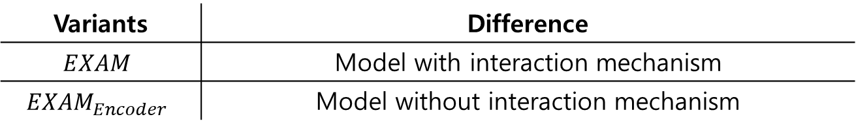
Experiment
Baseline
- The state-of-the-art models in each dataset.
Model Variant
Variants | Difference
$$EXAM$$ | Model with interaction mechanism
$$EXAM_{Encoder}$$ | Model without interaction mechanism
Notes:
3번째 experiment rnn tran 그것도 베이스라인

Slide 103
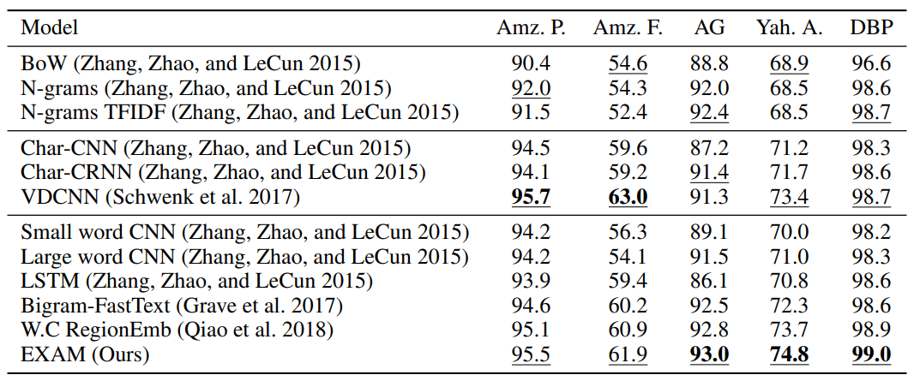
Experiment
[Multi-Class Classification]
Char-based
model
Word-level
model
First,
The model with interaction layer performs better on three datasets than the char-based baseline model.
Notes:
싹다 마침표 / 대문자 / Second 수정

Slide 104
Experiment
[Multi-Class Classification]
Char-based
model
Text-level
model
Word-level
model
First,
The model with interaction layer performs better on three datasets than the char-based baseline model.
Second,
The model shows better performance by reflecting the relationship between words and classes than text-level based baseline model.
Notes:
싹다 마침표 / 대문자 / Second 수정

Slide 105
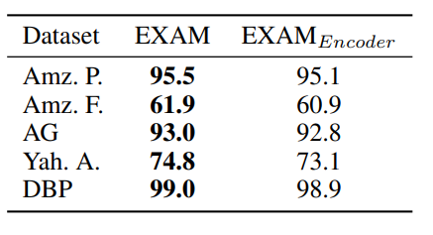
Experiment
[Comparison of whether or not to use interaction]
First,
The model using interaction layer improves performance by 0.1 ~ 1.7% compared to the model without the layer.
Notes:
말을 조금더 자세하게 다듬을 것

Slide 106
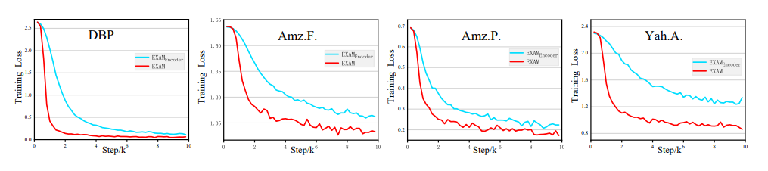
Experiment
[Comparison of whether or not to use interaction]
First,
The model using interaction layer improves performance by 0.1 ~ 1.7% compared to the model without the layer.
Second,
The interaction brings faster convergence than Encoding-Based model.
Notes:
뭐에대한 퍼포먼스, ngram 정확한 해석 (어디에서 어디까지 그램이냐)

Slide 107
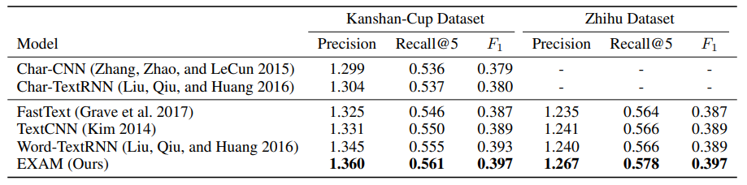
Experiment
[Multi-Label Classification]
Char-based
model
Text-level
model
Word-level
model
The model performs better than the baselines.
Notes:
뭐에대한 퍼포먼스, ngram 정확한 해석 (어디에서 어디까지 그램이냐)

Slide 108
Experiment
[Multi-Label Classification]
Char-based
model
Text-level
model
Word-level
model
The model performs better than the baselines.
The word-level interaction are more important than global text-level representation.
Notes:
뭐에대한 퍼포먼스, ngram 정확한 해석 (어디에서 어디까지 그램이냐)

Slide 109
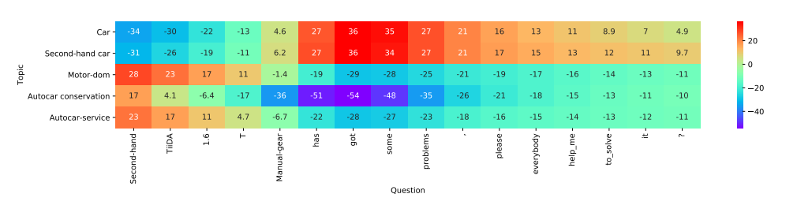
Experiment
[Relationship between words and classes]
Notes:
뭐에대한 퍼포먼스, ngram 정확한 해석 (어디에서 어디까지 그램이냐)

Slide 110
Experiment
[Relationship between words and classes]
Notes:
뭐에대한 퍼포먼스, ngram 정확한 해석 (어디에서 어디까지 그램이냐)

Slide 111
Experiment
[Relationship between words and classes]
Notes:
뭐에대한 퍼포먼스, ngram 정확한 해석 (어디에서 어디까지 그램이냐)

Slide 112
Conclusion
This model performs better by reflecting the relationship
between words and classes.
The interaction layer brings not only performance improvement
but also faster convergence.
They proves the importance of interaction mechanisms in text classification.
Notes:
마침표

Slide 113
Q&A
Q & A
Notes:
FastText 수정사항 embedding
논문두개합치기
해싱 어떻게든
실험은 분리, / 정확한설명덧붙어ㅕ서
Task 각각에 대해 간단하게

Slide 114
Q&A
Q & A
Notes:
FastText 수정사항 embedding
논문두개합치기
해싱 어떻게든
실험은 분리, / 정확한설명덧붙어ㅕ서
Task 각각에 대해 간단하게

Slide 115
Model
[EXplicit interaction Model(EXAM)]
Sentence length is short
Sentence length is long
GRU
Region Embedding

Slide 116
Model
[EXplicit interaction Model(EXAM)]
Multi-Class Classification
Multi-Label Classification
Softmax
Sigmoid

